Slide 1
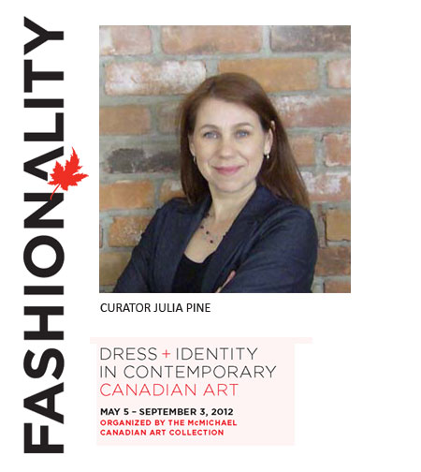
Notes:
“Fashionality” is a newly coined play on words that refers to the visual culture and semiotics of dress and adornment. Combining the words “fashion,” “personality,” and “nationality,” it signals the interplay between clothing, identity, and cultural affinity. “Fashionality” focuses on works of art that employ dress as a primary medium, subject or sign.

Slide 2
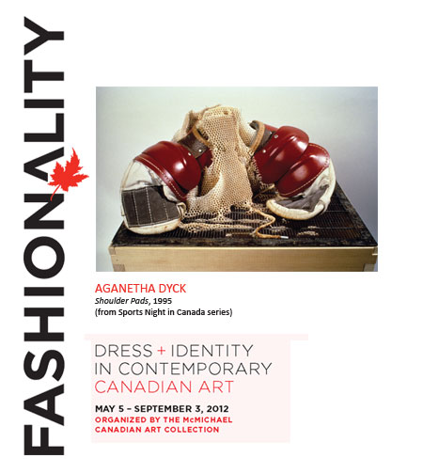
Notes:
Aganetha Dyck (b. 1937) was born near Winnipeg, Manitoba. She is a Canadian artist who is interested in environmental issues, and specifically in the power of the small and inter-species communication and collaboration. Sports Night in Canada was a collaborative work with the honeybees, funded by the Manitoba Arts Council and the Winnipeg Art Gallery. This was a performance in a clearing in the woods, an apiary of nine hives turned into a gallery with work in progress. Beekeeper Phil Veldhuis was the director, Dyck was the tour guide, and the honeybees were the architects/artists and the apiary beehive guards. We organized bi-weekly public tours of approximately twenty people at a time for this work.

Slide 3
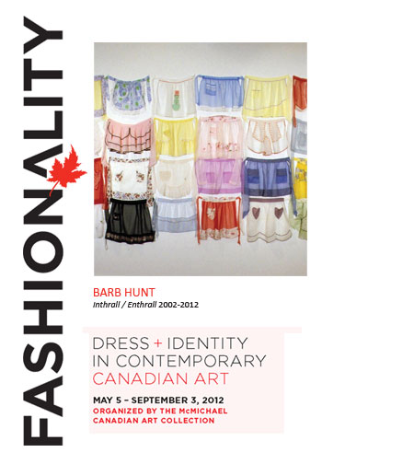
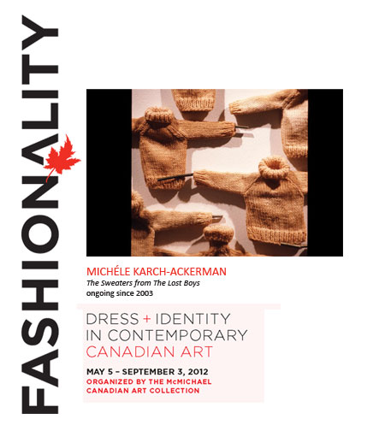
Notes:
Barb Hunt received a Diploma in Studio Art at the University of Manitoba and completed an MFA at Concordia University, Montreal. Her art practice is based in textiles, and recent work focuses on gender and the rituals of mourning, particularly those of Newfoundland. She is interested in the routines of everyday life and domesticity, which are often relegated to the "feminine" realm, often thought of as the small and less important. She plays with gender stereotypes by interweaving both contradictory and supportive correlations between material, image, and process. By giving value to personal detritus and almost forgotten remnants, she hopes to recuperate lost histories and acknowledge the value of ritual.

Slide 4
Notes:
Michèle Karch-Ackerman (b. 1962) is an installation artist who lives in Buckhorn, Ontario. She is a graduate of the Ontario College of Art and Design, and has taught at various institutions including Halliburton School of the Arts, Loyalist College, Trent University and the Royal Ontario Museum. "The Sweaters" is part of a nationally-touring installation which explores the loss of young lives during the First World War, and in particular, the Newfoundland regiment who fought in the battle of Beaumont Hamel. It weaves together the story of James Barrie's Peter Pan with the stories of so many lives lost in the First World War, and expresses loss, remembrance, and consolation.

Slide 5
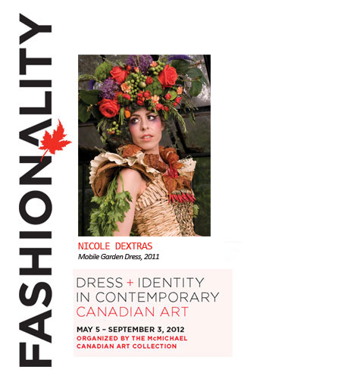
Notes:
Nicole Dextras (b. 1956) is a Vancouver-based environmental artist who works in a variety of media including sculpture, interactive public installation and photography. The Weedrobes philosophy consists of raising awareness about the impact of industry on our ecosystem while also understanding the complex human need for adornment. These principles are based on her personal experiences within the garment industry, from factory to retail, which have led her to conclude that, while it may be impractical to wear clothing made from leaves, our future depends on the development of sustainable resources.

Slide 6
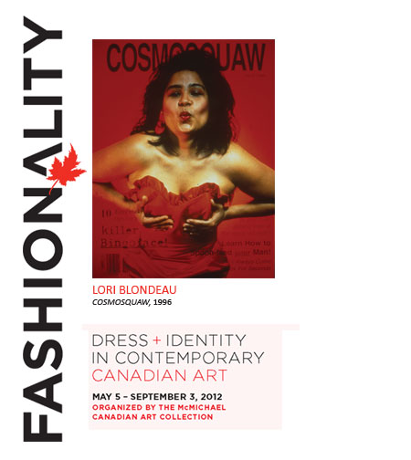
Notes:
Lori Blondeau (b. 1964) is a Cree/Saulteaux/Metis artist originally based in Saskatoon, but now living in California. She holds an MFA from the University of Saskatchewan, and has sat on the Advisory Panel for Visual Arts for the Canada Council for the Arts. She is also a co-founder and the current director of TRIBE, a Canadian aboriginal arts organization. Her work explores the influence of popular media and culture (contemporary and historical) on Aboriginal self-identity, self-image, and self-definition. She is currently exploring the impact of colonization on traditional and contemporary roles and lifestyles of Aboriginal women. She deconstructs the images of the Indian Princess and the squaw and reconstruct an image of absurdity and inserts these hybrids into the mainstream. The performance personas she has created refer to the damage of colonialism and to the ironic pleasures of displacement and resistance.

Slide 7
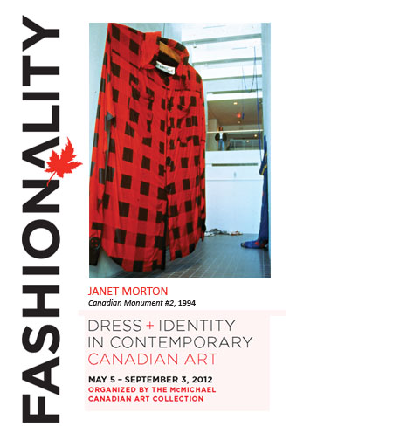
Notes:
Janet Morton (b. 1963) is a Guelph-based artist who has exhibited extensively throughout Canada and abroad. Since 1992, she has been producing conceptually based work, using knitting and sewing symbolically and subversively. In addition to the enormous items of clothing in the current exhibition, she has executed projects such as a cosy for an entire house, and garments for tropical zoo animals. Despite the humorous notes in much of Morton's work, it frequently touches upon social issues such as homelessness, colonialism, and excess. Memorial was inspired by the jumbo icons along the Trans-Canada highway, such as the Wawa Goose, the Jellicoe Snowman and the Big Nickel. She wanted to examine the contradictory space these beloved symbols occupy in our cultural landscape by making her own monument to Canada and then juxtaposing it with public sculptures and statuary.

Slide 8
Works Cited
Blondeau, Lori. Cosmosquaw. 1996. McMichael Canadian Art Collection, Ontario. Canada. McMichael Canadian Art Collection. Web. 7 June 2013.
Dextras, Nicole. Mobile Garden Dress. 2011. McMichael Canadian Art Collection, Ontario, Canada. McMichael Canadian Art Collection. Web. 7 June 2013.
Dyck, Aganetha. Shoulder Pads. 1995. McMichael Canadian Art Collection, Ontario, Canada. McMichael Canadian Art Collection. Web. 7 June 2013.
Hunt, Barbara. Inthrall/Entrhall. 2002-2012. McMichael Canadian Art Collection, Ontario. Canada. McMichael Canadian Art Collection. Web. 7 June 2013.
Karch-Ackerman, Michèle. The Sweaters from The Lost Boys. Ongoing since 2003. McMichael Canadian Art Collection, Ontario. Canada. McMichael Canadian Art Collection. Web. 7 June 2013.
Morton, Janet. Canadian Monument #2. 1994. McMichael Canadian Art Collection, Ontario. Canada. McMichael Canadian Art Collection. Web. 7 June 2013.
Pine, Julia. “Curatorial Statement”. McMichael Canadian Art Collection, Ontario, Canada. McMichael Canadian Art Collection. Web. 7 June 2013.

